Slide 1
Emotion Classification for Cross Lingual Song Lyrics
Group-20

Slide 2
ABSTRACT
This paper is an attempt to detect the emotions of songs without any human experts, only using machine learning. Classification models have been applied and the songs are categorized into five emotional moods. Our results are encouraging for mining the lyrical content of songs for specific emotions since they produce classification models that are understandable to humans and produce conclusions that are consistent with commonsense perceptions of particular emotions

Slide 3
RESEARCH OBJECTIVE
Selection of music for public spaces
Analyzing historic and social values through music.
Working on Multiple Emotions

Slide 4
PROBLEM STATEMENT
The goal of this project was to create a recommendation system that can determine if a song is happy or sad based on its lyrics for one or multiple languages. This system may be used to search song libraries and choose music based on emotion in a variety of social scenarios.
In the system we’ve implemented,
Using a naive Bayes classifier to predict song sentiment solely from song lyrics.
Using the algorithm as the foundation for a music recommendation system.
Identifying cheerful music with high accuracy using text qualities gleaned from song lyrics.

Slide 5
LITERATURE REVIEW
Few Previous Works
Authors Minho Kim and Hyuk-Chul - feature selection classification - method - identifying lyrics-based emotion.
Authors Serhat Hizlisoy a, Serdar Yildirim b, and Zekeriya Tufekci - employing convolutional long short-term memory deep neural networks - recognize the emotions in music.
Two methods - categorizing => categorical and dimensional.
Second method - Dimensional space - Emotions are portrayed.
Panda et al. offered - a library of 903 audio samples - classified into 5 emotion groups - MIREX mood classification task.
1240 pieces of Chinese pop music - valence and arousal in a database - Y.H. Yang et al.

Slide 6
DATASET, DATA DESCRIPTION, AND PRE-PROCESSING
Dataset from Kaggle.
18000 songs, categories are - Artist, Title, Year, Genre, Lyrics, Length, and Labels.
Categorized into 5 types - Sadness, Romance, Violence, Obscene, and Feelings.
Data Preparation or Data Preprocessing - preprocessing techniques used here are =>
* Label Encoder
* Porter-Stemmer
* Stopword removal
* Count Vectorization
* Tfidf Vectorization
* The α smoothing parameter

Slide 7
METHODOLOGY
Models:
Multi-Variate Bernoulli Naive Bayes
Multinomial Naive Bayes
Gaussian Naive Bayes

Slide 8
How they are implemented?
Sadness, violence, and obscene words were marked as Negative words, and the rest were marked as positive words.
The model was selected using grid search and cross validation on a 2054 training dataset in order to maximize performance via F1-score.
Final model’s performance was assessed to 450 song validation dataset out of 10,000 songs of the dataset.
The receiver operating characteristics area under the curve (ROC auc), recall, accuracy, F1-score and precision were the five metrics used to evaluate performance. BHAI FAST

Slide 9
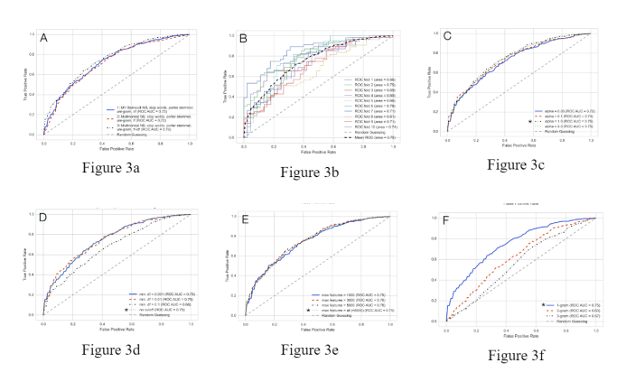
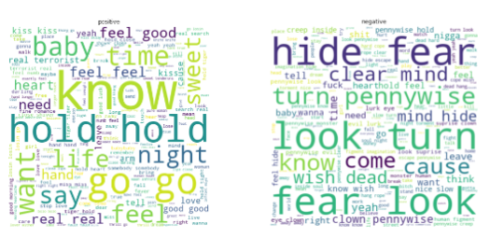
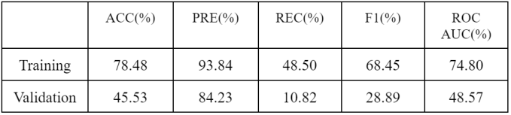
Result Analysis

Slide 10
CONCLUSION

